Slide 1
MACHINE LEARNING
LOGISTIC REGRESSION

Slide 2
Logistic regression
Logistic Regression is a Statistical Method used for binary Classification problems.
Logistic Regression predicts the probability of a binary outcome.
Binary classification – binary values(discrete)
Multi Class Classification – More than a value.

Slide 3
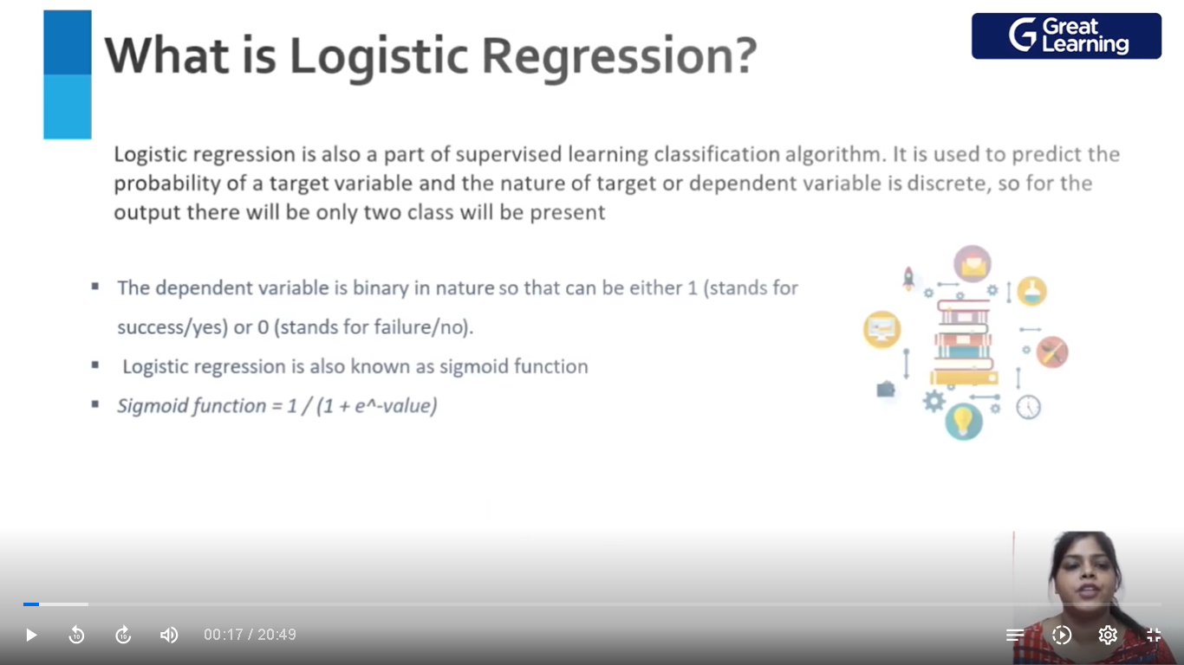

Slide 4
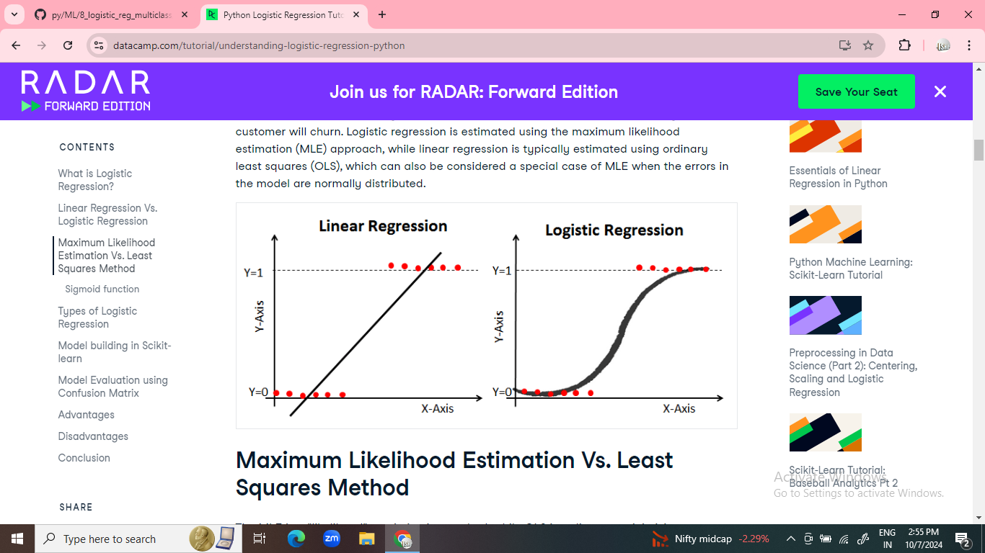

Slide 5
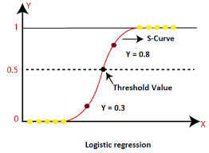
LOGISTIC REGRESSION

